Slide 1

Classification of Fake News vs Real News Articles
Adam Jauregui

Slide 2

Goal
The inspiration for this project was to train and test Machine Learning and Deep Learning Neural Network Models for the classification of whether a news article was “real” (defined as an actual published article from a reputable news source) or “fake” (defined as an article not published from a reputable news source).
The model will learn from a data set that contains a column which houses an article’s text in a single cell; with the target variable being whether the article was real or fake.

Slide 3
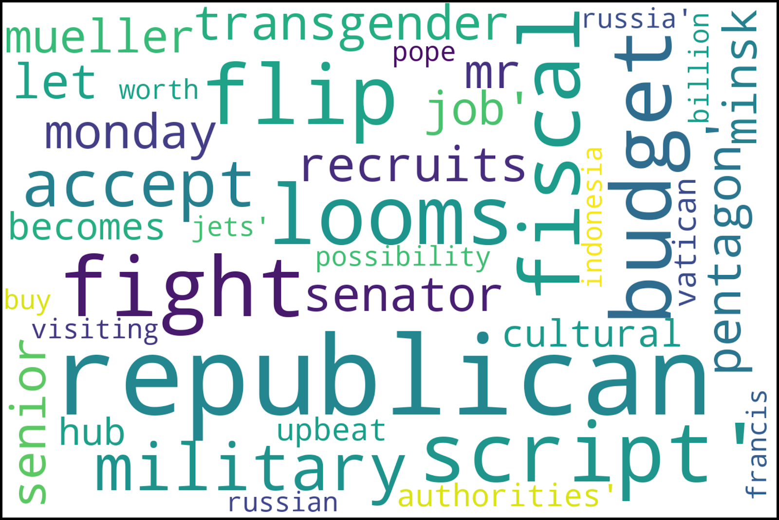
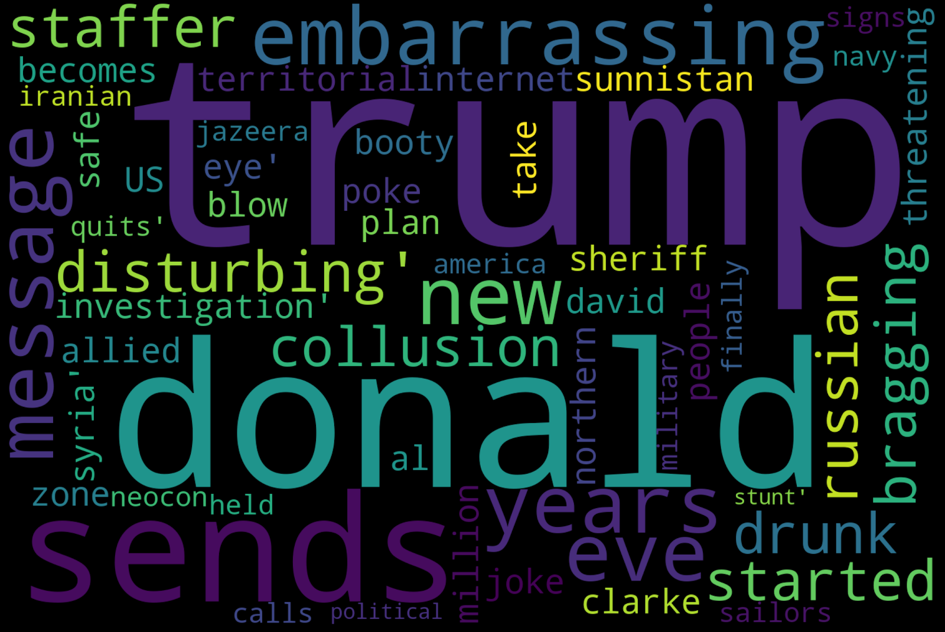
Word Cloud of Real vs Fake News Articles
Real
Fake

Slide 4

Text Pre-Processing
Clean up the text data before modeling for optimum results. Involves:
  Removing accented characters (ex.: à, é, etc.)
  Expanding contractions (ex.: “don’t” into “do not,” etc.)
  Remove special characters (ex.: #, !, @, etc.)
  Remove stop-words (ex.: “the,” “of,” etc.)
  Lowercase all words (except those occurring in the middle of a sentence)

Slide 5
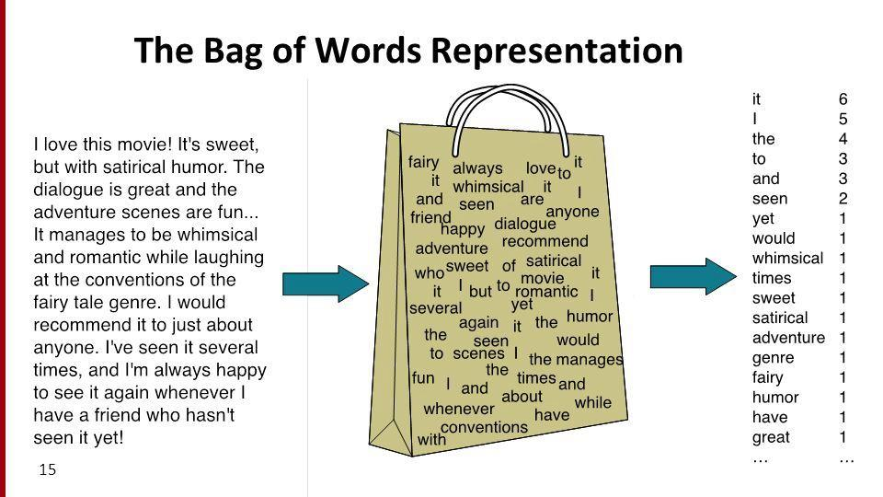
Natural Language Processing: “Bag of Words” Model
To model the text data, we must convert the words into a vector of numbers.
One method is to use the “bag of words” (BOW) model.
Each word is treated independently of the other words. All ordering of the words and grammar is tossed aside.

Slide 6
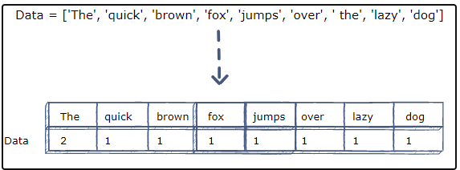
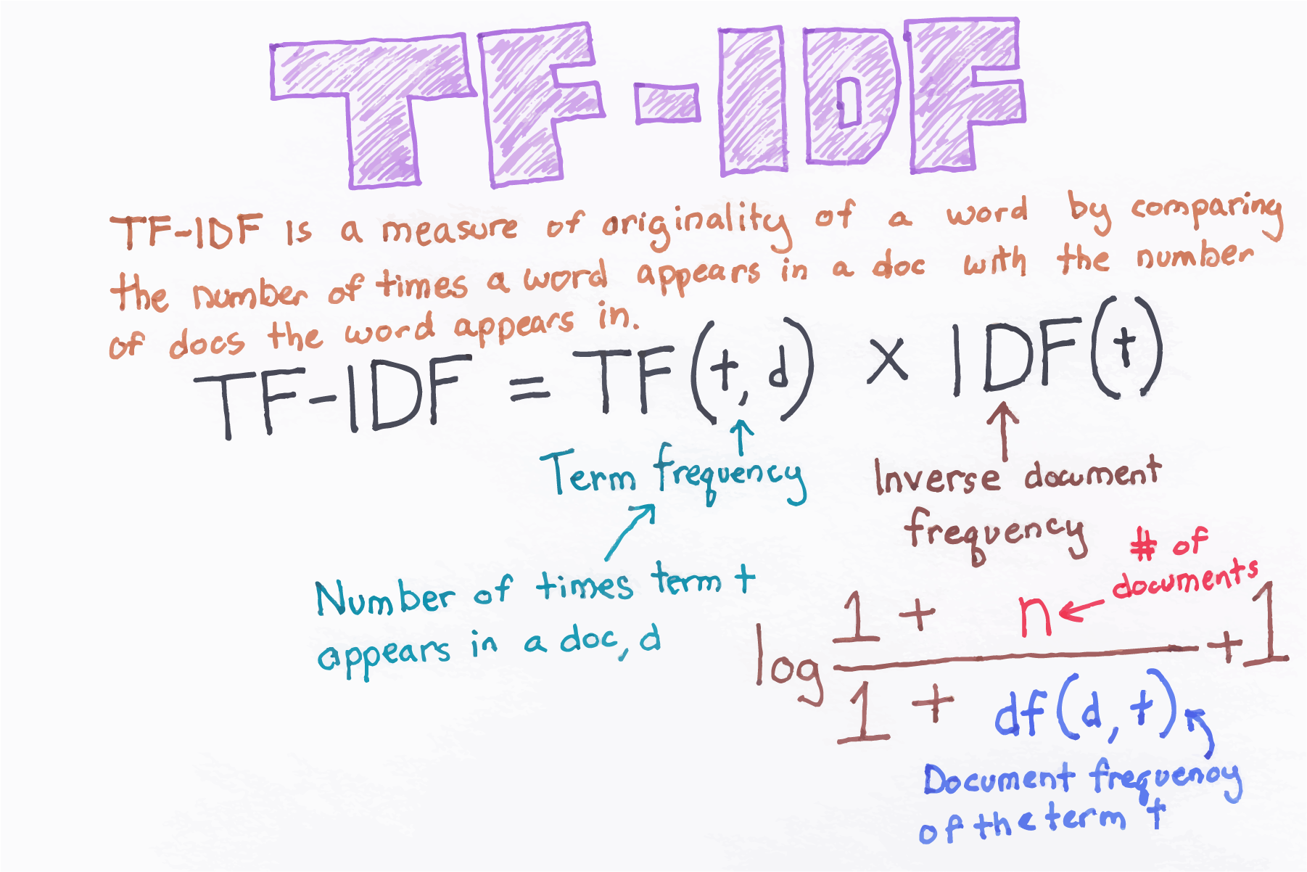
Bag of Words:
Count- vectorizer & TFIDF- Vectorizer
CountVectorizer
Convert the text data from each article into a vector of numbers.
Obtain the counts of how many times each word occurs within the article’s text, assigning a numeric vector to each word of that count.
TFIDFVectorizer
Adds more weight to words that occur within a document but not across documents

Slide 7
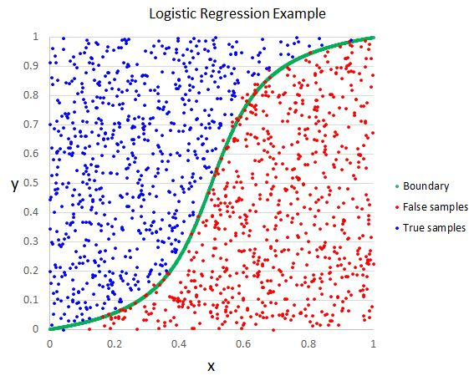
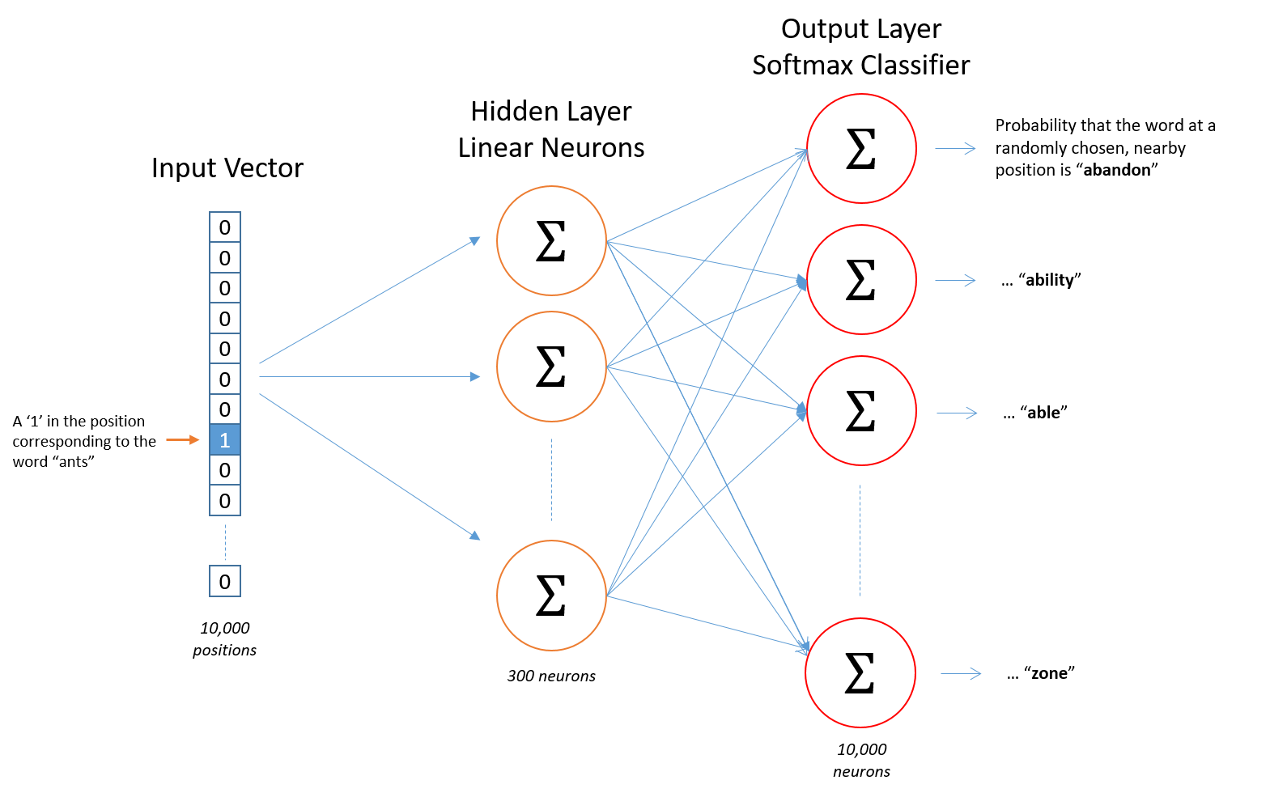
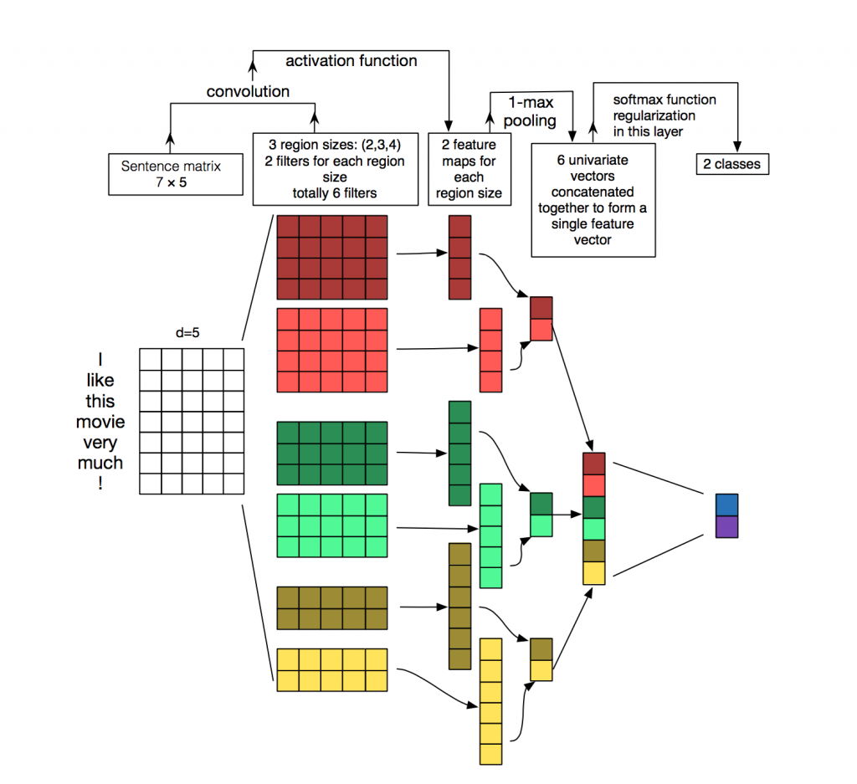
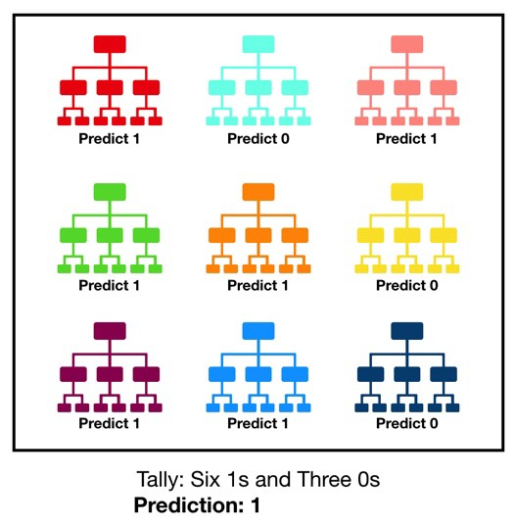
Modeling our text data
Machine Learning Models
Deep Learning Models
Binary Logistic Regression
  Supervised classification algorithm used to predict the probability of a binomial target variable (ex.: yes/no), high/low, etc.)
Random Forest
  Ensemble method using many decision trees together to make a prediction
Basic Deep Learning Networks
  Mapped words to vectors using Word2Vec model
Convolutional Neural Networks (CNN)
  Applies a sliding window function over a matrix of word embeddings

Slide 8
Model Evaluation: confusion Matrix
Logistic Regression
Word2Vec DNN
 | Actually Real | Actually Fake
Predicted Real | 4,327 | 8
Predicted Fake | 11 | 4,508
 | Actually Real | Actually Fake
Predicted Real | 4,323 | 12
Predicted Fake | 12 | 4,507
Precision: 0.9982
Recall: 0.9975
Accuracy: 0.9979
Precision: 0.9972
Recall: 0.9972
Accuracy: 0.9973
Random Forest
Convolutional Neural Networks
 | Actually Real | Actually Fake
Predicted Real | 4,324 | 11
Predicted Fake | 30 | 4,489
 | Actually Real | Actually Fake
Predicted Real | 4,332 | 3
Predicted Fake | 2 | 4,517
Precision: 0.9975
Recall: 0.9931
Accuracy: 0.9954
Precision: 0.9993
Recall: 0.9995
Accuracy: 0.9994

Slide 9
Conclusions
The best model was the CNN Model, which had an astounding 99.9% accuracy!
The Logistic Regression did surprisingly well when using the CountVectorizer algorithm, outperforming even the Deep Learning Model.
All the models did very well however by the metrics, obtaining all an accuracy of at least 99%
Would like to perhaps obtain a better data set in the future that shows where the fake news articles came from.

